Slide 1
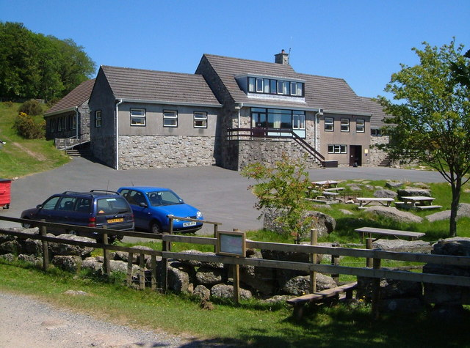
Dartmoor residential Year 4 (Wednesday 26th March- Friday 28th March)
Residential Centre

Slide 2
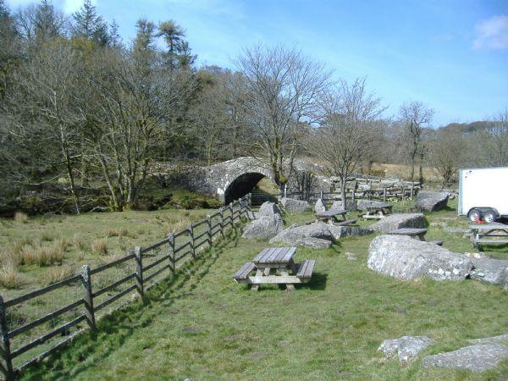
The Grounds
There is a large fenced area to the back perfect for playing hide and seek and will be used for part of the orienteering exercise on the Friday morning.
To the front of the property there are picnic benches and a large camp fire spot where the children and staff can roast marshmallow, sing songs and try some more adventurous cooking!

Slide 3
The wooded area.
Beyond the grounds at the back of the centre there is an enclosed wooded area in which the children will be playing many of their team building games and the building of dens.
Children will not be allowed in any of these areas without adult supervision.

Slide 4
Inside the centre.
There is a kitchen in which a lady called Annie prepares and cooks breakfast and dinner for the children.
Breakfast is a cooked breakfast of sausages/bacon and egg followed by cereal and toast.
Dinner is hot and very much to children’s taste, including lots of cake!
After breakfast, the children will have tidying duties and then will prepare their own lunches!

Slide 5
Dormitories.
There are 2 dormitories for the children. Upstairs has 22 beds and down stairs has 20 beds.
There are 3 dormitories for adults, these are all down stairs.
The upstairs dormitory has a toilet and sink in it. There are further toilets down stairs and shower rooms which will be used by the boys.
The downstairs dormitory has it’s own en suite showers and toilets. These dormitories are also next to the staff dormitories.

Slide 6
Shared spaces – common room.
There is a large, open common room on the ground floor which has a wood burner in, soft chairs and is also where the children set up tables and benches for eating all their meals.
There is a stone spiral staircase that leads to the upstairs dormitory.
All doors are alarmed . Certain doors cannot be locked, however if they were to be opened then this would set off a loud alarm!

Slide 7
Daily routine and activities.
Wednesday
10.15- 12.00 | 12.00-1.00pm | 1.00- 5.00pm | 5.00-5.30pm | 5.30- 6.30pm | 7ish-9pm
Arrival and kitting out of children with waterproofs etc. Allocate slots in boot room. Safety talk and fire drill led by leaders at the centre. Children shown to dormitories and given time to settle in, followed by tour around building and grounds. Rules will be established. Talk about boundaries in and out. | Lunch: Children bring own packed lunch for first day. Children are expected to take responsibility of setting tables and clearing up after meals. Expectations of meal time behaviour made explicit and reinforced constantly. Down time in common room or games outside whilst 2 adults prepare afternoon activities. | Activities led by TPS staff: Team building games: each game is led by an adult. 4 activities are rotated. Ground sheet folding. Stepping stones and water. Shepherd and sheep. The web. Treasure hunt (collect items on list within the grounds and then team create a collage picture within a hoop or on a sheet of paper.) Prizes possible | Down Time Clean up and down time in common room. Games, books, and activities are brought and provided for the children to use. | Children prepare for eating and clear up after dinner as per rota groups. | All children on night walk led by centre staff. Return for story, hot chocolate, brush teeth and bed. No movement after 10 pm.

Slide 8
Thursday
Getting up 7.30am | Breakfast 8 – 9 am | Morning activities 9.30am – 1.00pm | Lunch staggered 12.00 – 2.30 pm | Afternoon 1.30 – 5.30 pm | Dinner 5.30 – 6.30pm | Evening 7 – 9.00pm | Bed – 9.00 – 9.30pm
Wake children up, wash/shower, dress and come down to set up for breakfast as per rota. | Children eat, clear up as per rota, make own packed lunch and then clear up again. | Activities led by centre staff: Weaselling with off site. | Weather depending, children to have lunch in grounds followed by time to play and relax with friends. (Timing depends on return of first weaselling group. 2nd group needs to be fed and ready to set off on return of first group. First group then has lunch) | Activities led by TPS staff: Shelter building Outdoor cooking | Children prepare for, eat and clear up after dinner as per rota groups. | Weather depending: Hide and seek, build fire, camp songs and marshmallows around the outdoor fire OR Indoor party games and quizzes. | Children wash/shower, change for bed, have hot chocolate, brush teeth and in dormitories for story. No movement after 10 pm.

Slide 9
Friday
Getting up 7.30am | Breakfast 8 – 9 am | Morning activity 9 – 11 am | 11 – 12.30pm | 12.30 – 2pm | 2pm – 3.15pm
Get up, wash and come down to set up for breakfast as per rota. | Children eat, clear up as per rota, make own packed lunch and then clear up again. | Activities led by TCP staff weather depending: Orienteering: In groups or pairs, children follow clues to check points within the grounds. Children will need to know symbols and be able to follow routes on maps. OR Easter egg hunt: Similar to orienteering but indoors with a code cracker to solve. | Tidy and pack Inspection of dormitories. Children out and ready to board coach as class 11 arrive. | Picnic on Dartmoor. Weather dependent, the coach will stop at Pork hill and children will have their packed lunch. | Children return to school for early collection. If time allows they can write a thank you letter to staff at the centre.

Slide 10
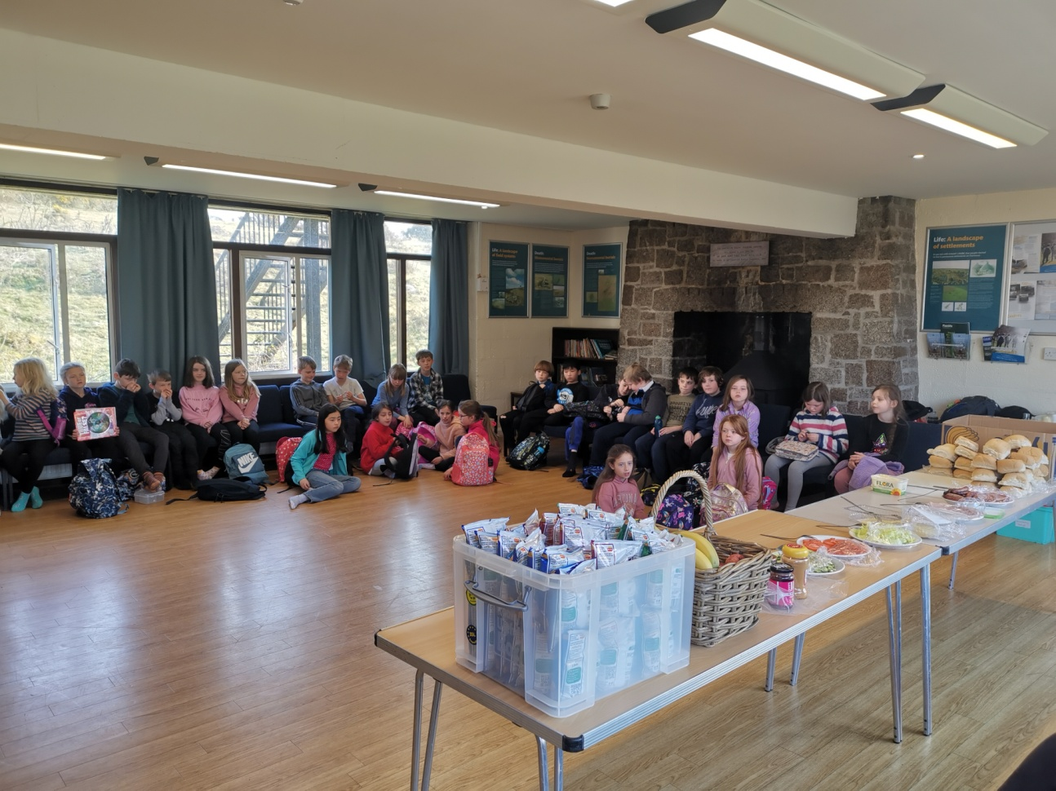
How are we going to get children to make their own lunches, do the dishes and complete rota tasks?
On arriving at the centre the children will be told of their groups. They will then be asked to think of their groups name and a pack promise made (made up by children but encouraging care, consideration and fun!)
Points will be awarded for tasks completed in groups e.g. best den building, tastiest campfire cooking, best sweepers etc.
Care will be taken to ensure that each group will win something each day.
Winners will be rewarded with some little prize e.g. rubber, bubbles etc.

Slide 11
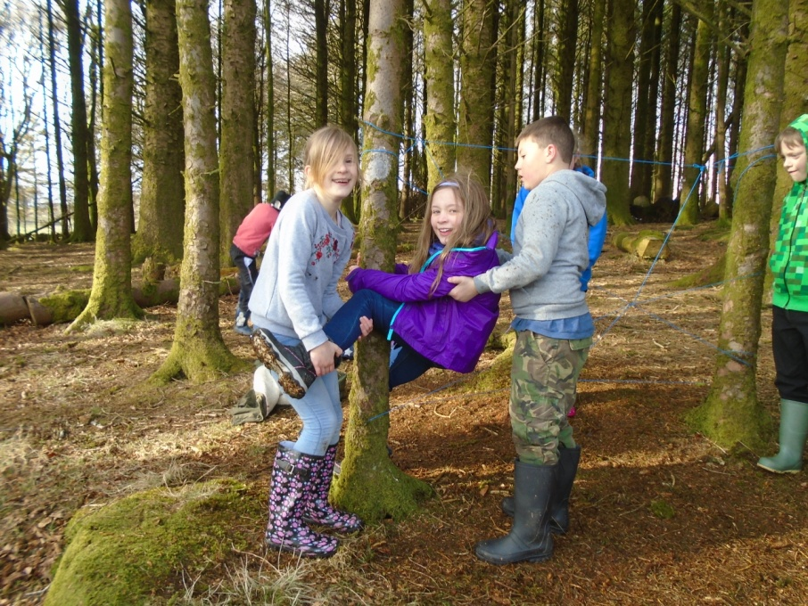
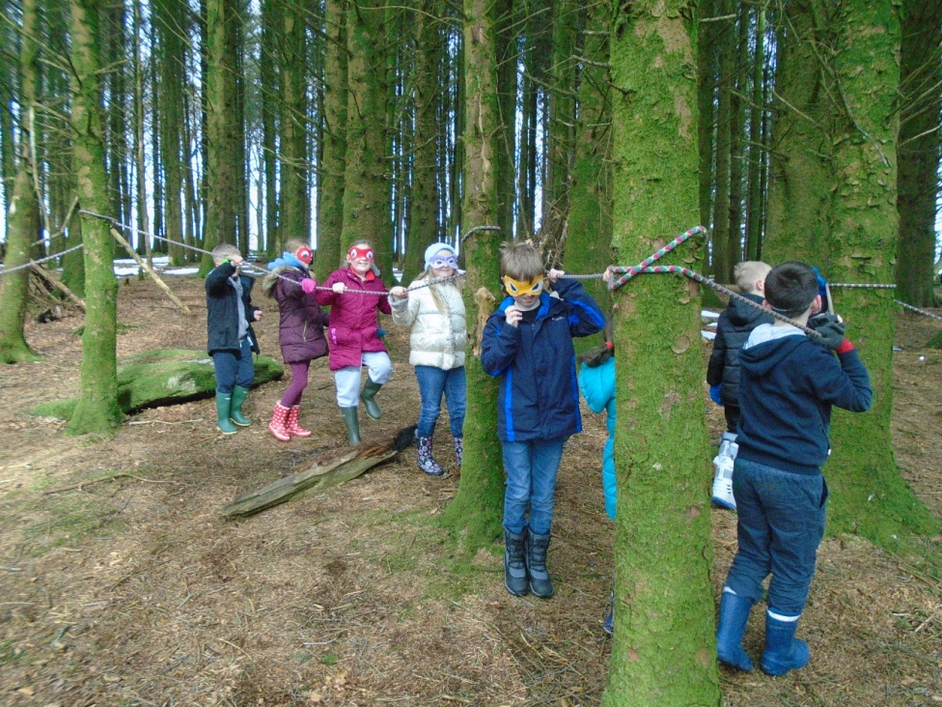
Previous residential trips
One of the memorable team building
exercises – by using only a limited
amount of equipment you need to get
your team and all of the equipment from one side of the river to the other.

Slide 12
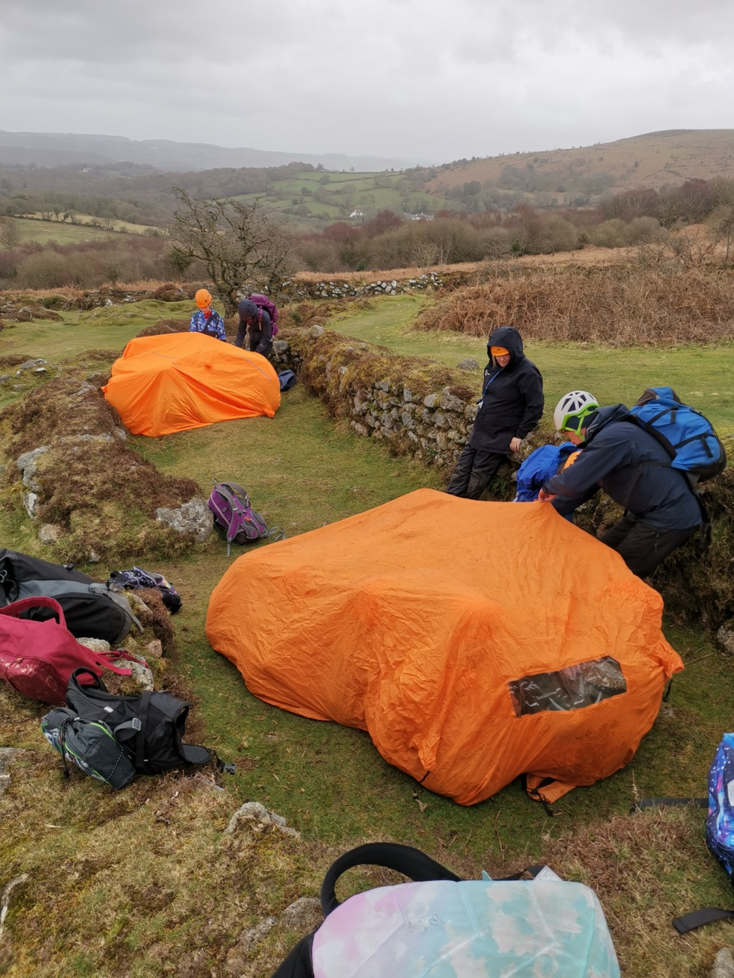
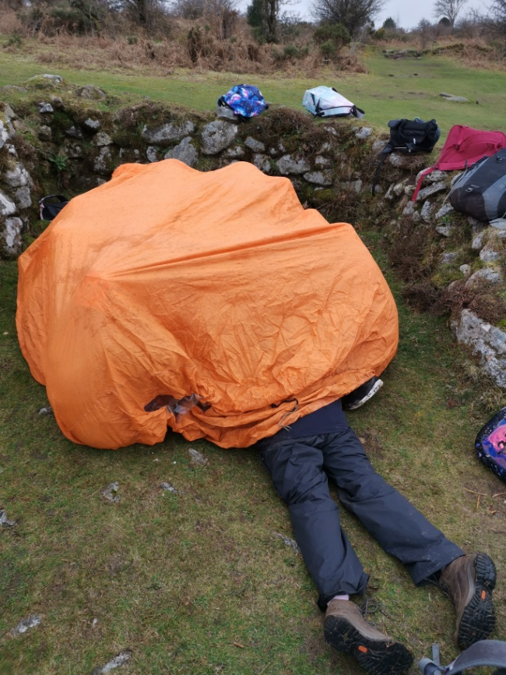
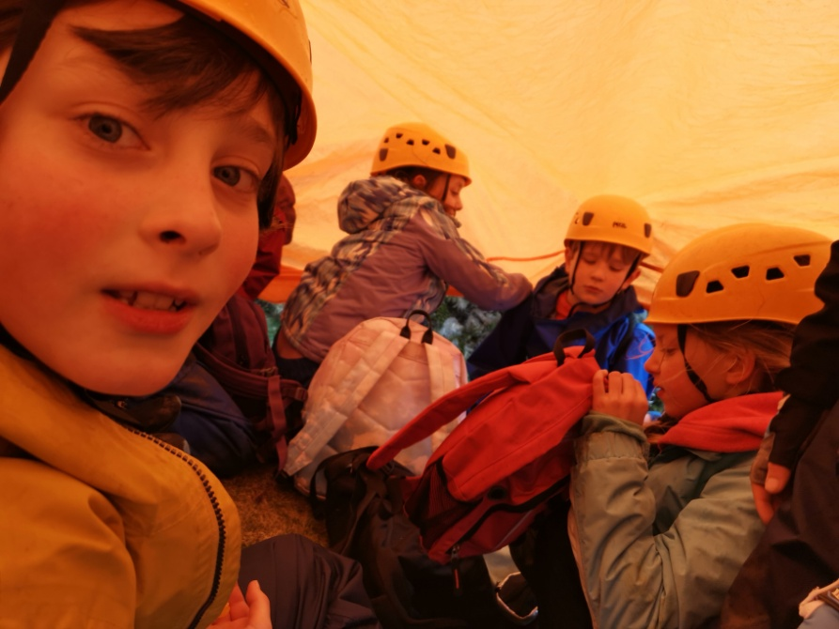

Slide 13
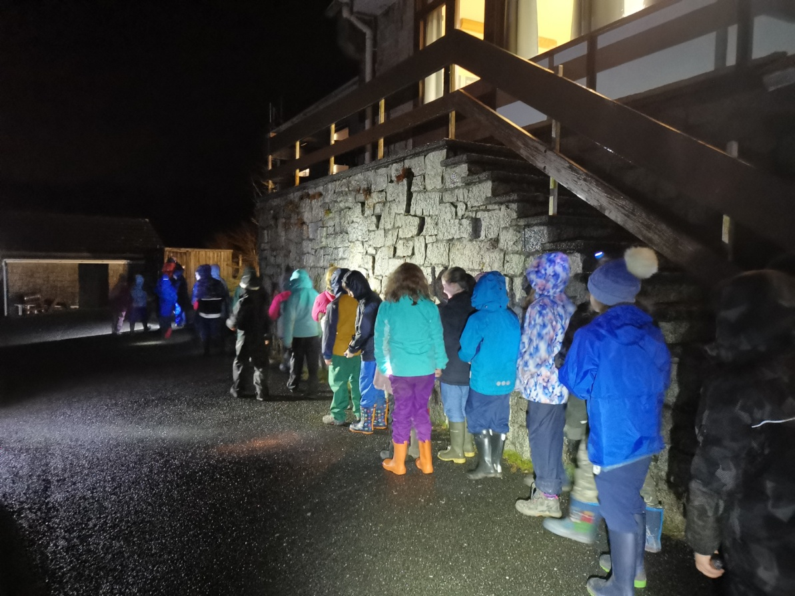

Slide 14
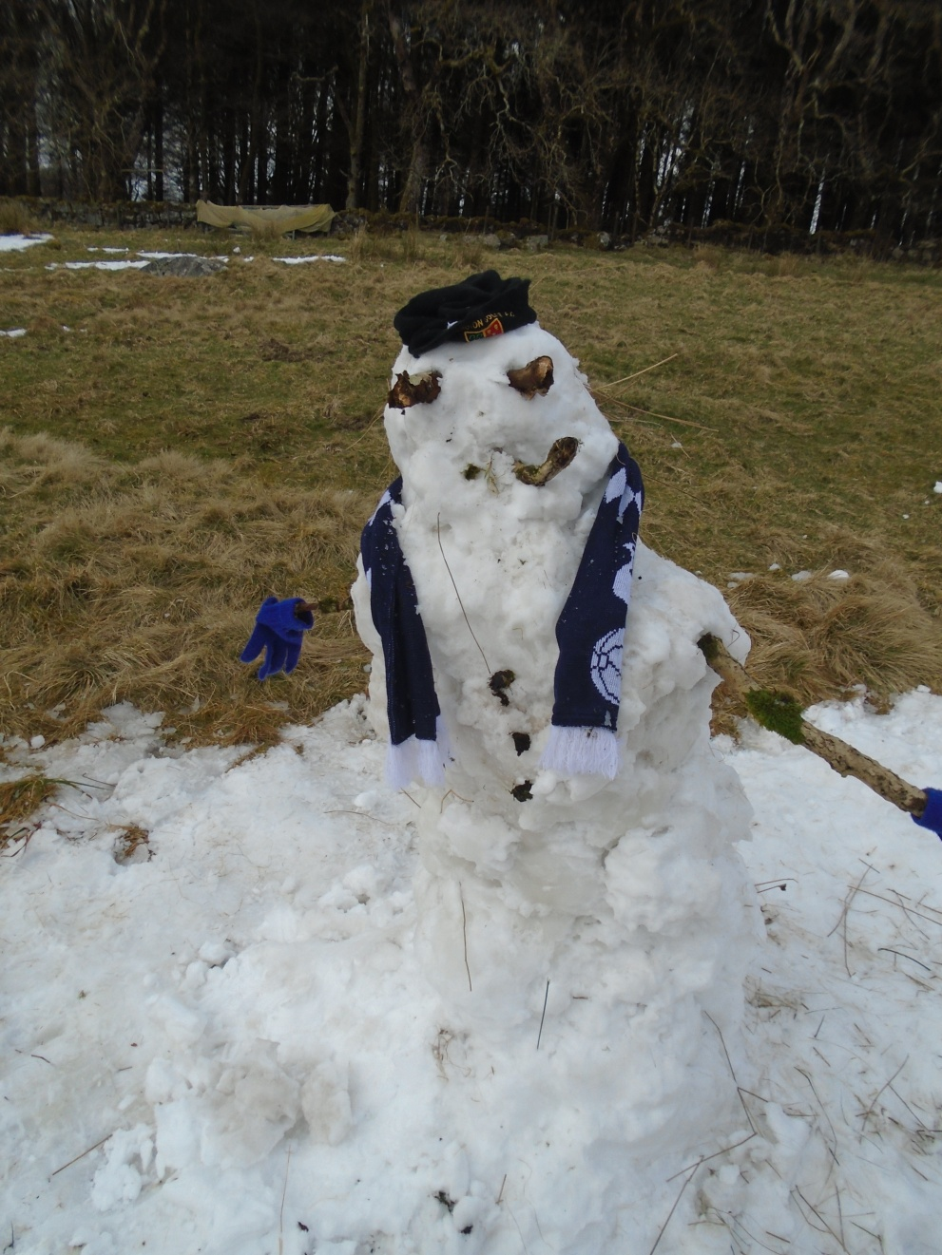
Another team building game:
A few years ago we had so much snow that we decided to work as teams to create the best snowman! What is hopefully becoming apparent is how active and involved the children are, learning people skills in ways we can’t offer in the normal school setting.

Slide 15
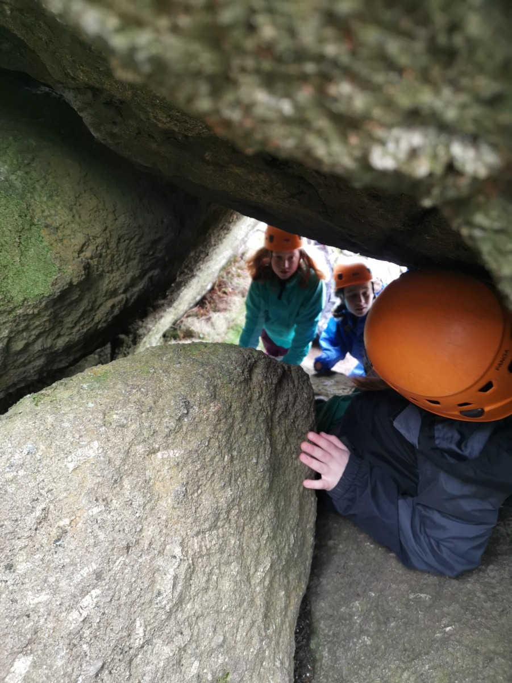
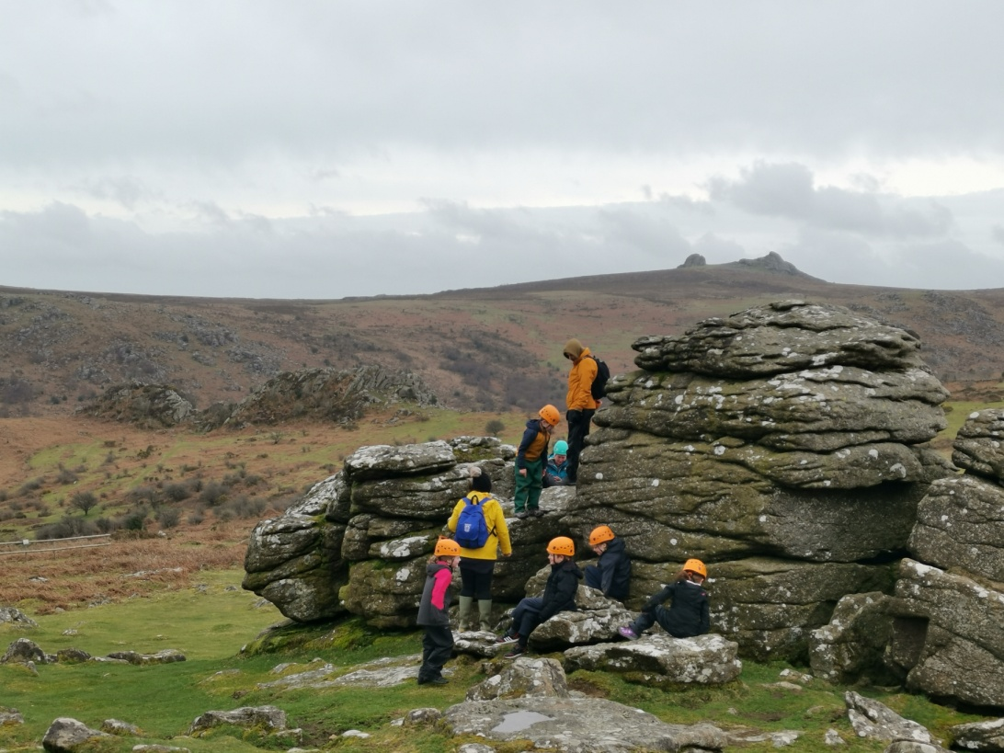
Weaselling is the squeezing
through holes and gaps in
the rocks.

Slide 16
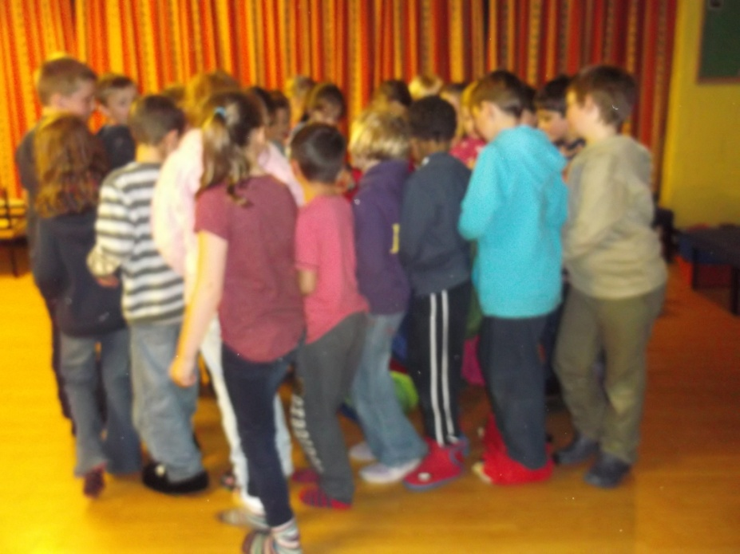
Evening fun…

Slide 17
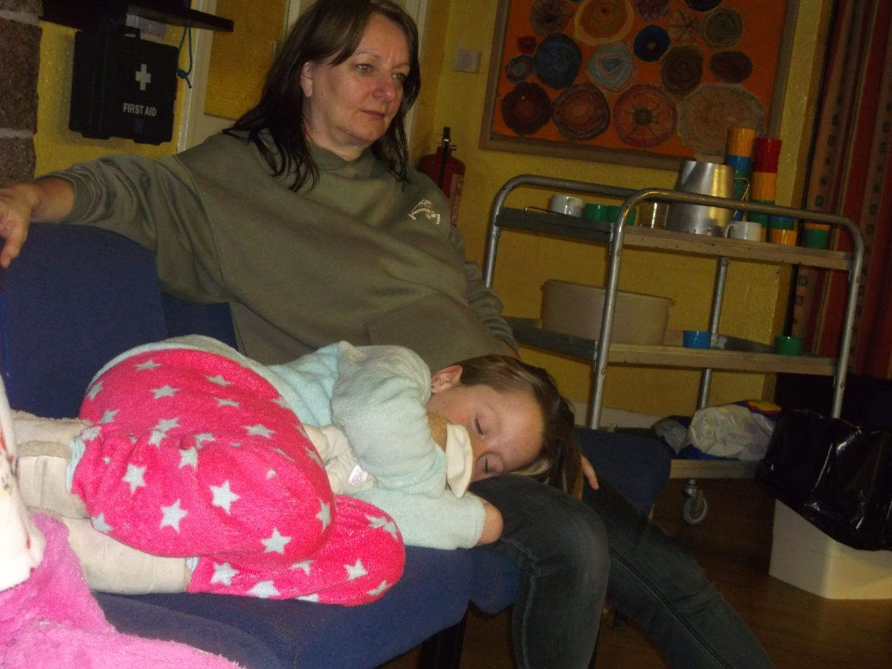
And down time…

Slide 18
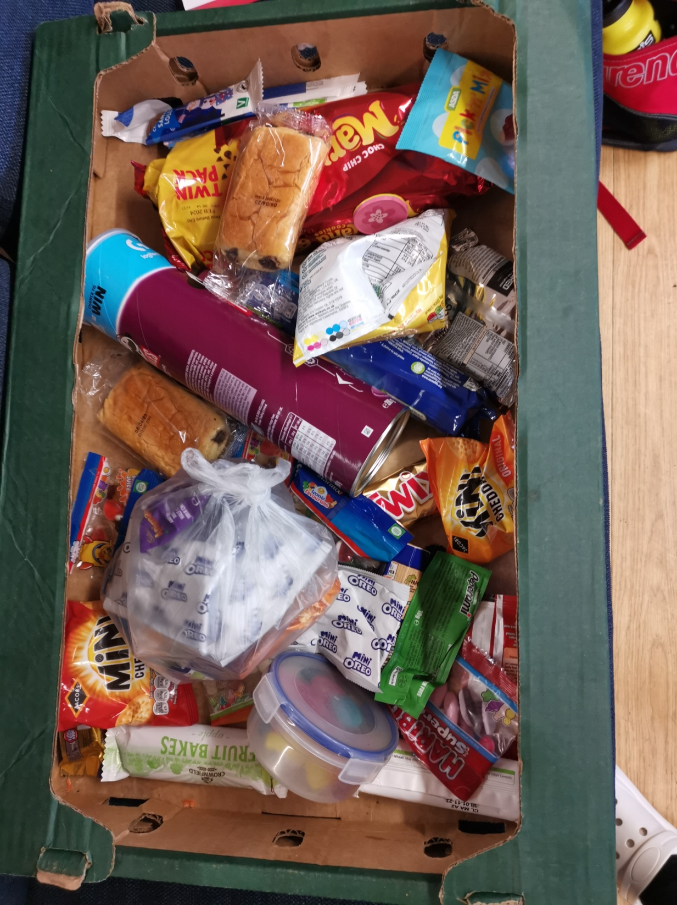
Please do not pack snacks!
We have children with allergies.
Also, if children are eating without our knowledge there is a risk of choking.

